Slide 1
富士通とSUSE Enterprise Storage

Slide 2

今日の爆発的なデータ増加
世界的なデータの増加状況（IDC 調査）
2015年: 10 ZB未満
2020年: 44 ZB
2025年: 180 ZB
出典： Forbes.com/sites/gilpress/2016/08/05/iot-mid-year-update-from-idc-and-other-research-firms/#415edd7555c5

Slide 3



SUSE Enterprise Storageと富士通サーバ
富士通とSUSEが、高い柔軟性とコスト効率を誇るプラットフォームと、制限なく拡張が行える堅牢なストレージをご提供します。
Notes:
Now you can get even more out of your SDS by choosing SUSE® Enterprise Storage on Fujitsu hardware—the ultimate solution for unlimited scalability that doesn’t blow your bottom line.
Together, SUSE and Fujitsu have provided more than 15 years of innovative, reliable and open solutions that can simplify complex enterprise IT management and reduce IT expenses. Fujitsu offers on-premises, hosted and cloud-based solutions—featuring SUSE® Linux Enterprise Server and SUSE Enterprise Storage—that you can count on for high performance, efficiency and reliability.
With SUSE Enterprise Storage on Fujitsu PRIMERGY or PRIMEFLEX systems, you get an enterprise-ready version of the open source, software-defined-storage solution Ceph built by two organizations that are both members of the Ceph advisory board.

Slide 4

富士通サーバーとSUSE Enterprise Storageソリューションのメリット
• コスト効果が高くスケールアウト環境に最適
• シンプルな運用管理
• ファイル、ブロック、オブジェクトストレージの統合
• 目的や用途に合わせて利用可能
コンプライアンス対応アーカイブ
低コストのバックアップ
大容量データ保管用ストレージなど
Notes:
Together the solution offers the features you need to face today’s challenges, allowing you to:
Cost-effectively scale your storage with per-node pricing, so per-gigabyte costs don’t weigh you down. Plus, you can take advantage of the affordable performance of Fujitsu PRIMERGY and PRIMEFLEX systems, rather than pay for expensive and specialized disk arrays.
Simplify management with SUSE Enterprise Storage’s self-healing properties or the pre-configured ease of PRIMEFLEX systems. With Ceph, a single administrator can easily manage six times the data that an admin in a block storage environment can.
Unify file, block and object storage in one solution.
Adjust the solution to fit your use case, whether that’s:
Compliance archiving
Data archive and bulk storage
Disaster recovery or disk-based backup
Storage of audio/video libraries and files for streaming
Storage for internal or private clouds

Slide 5
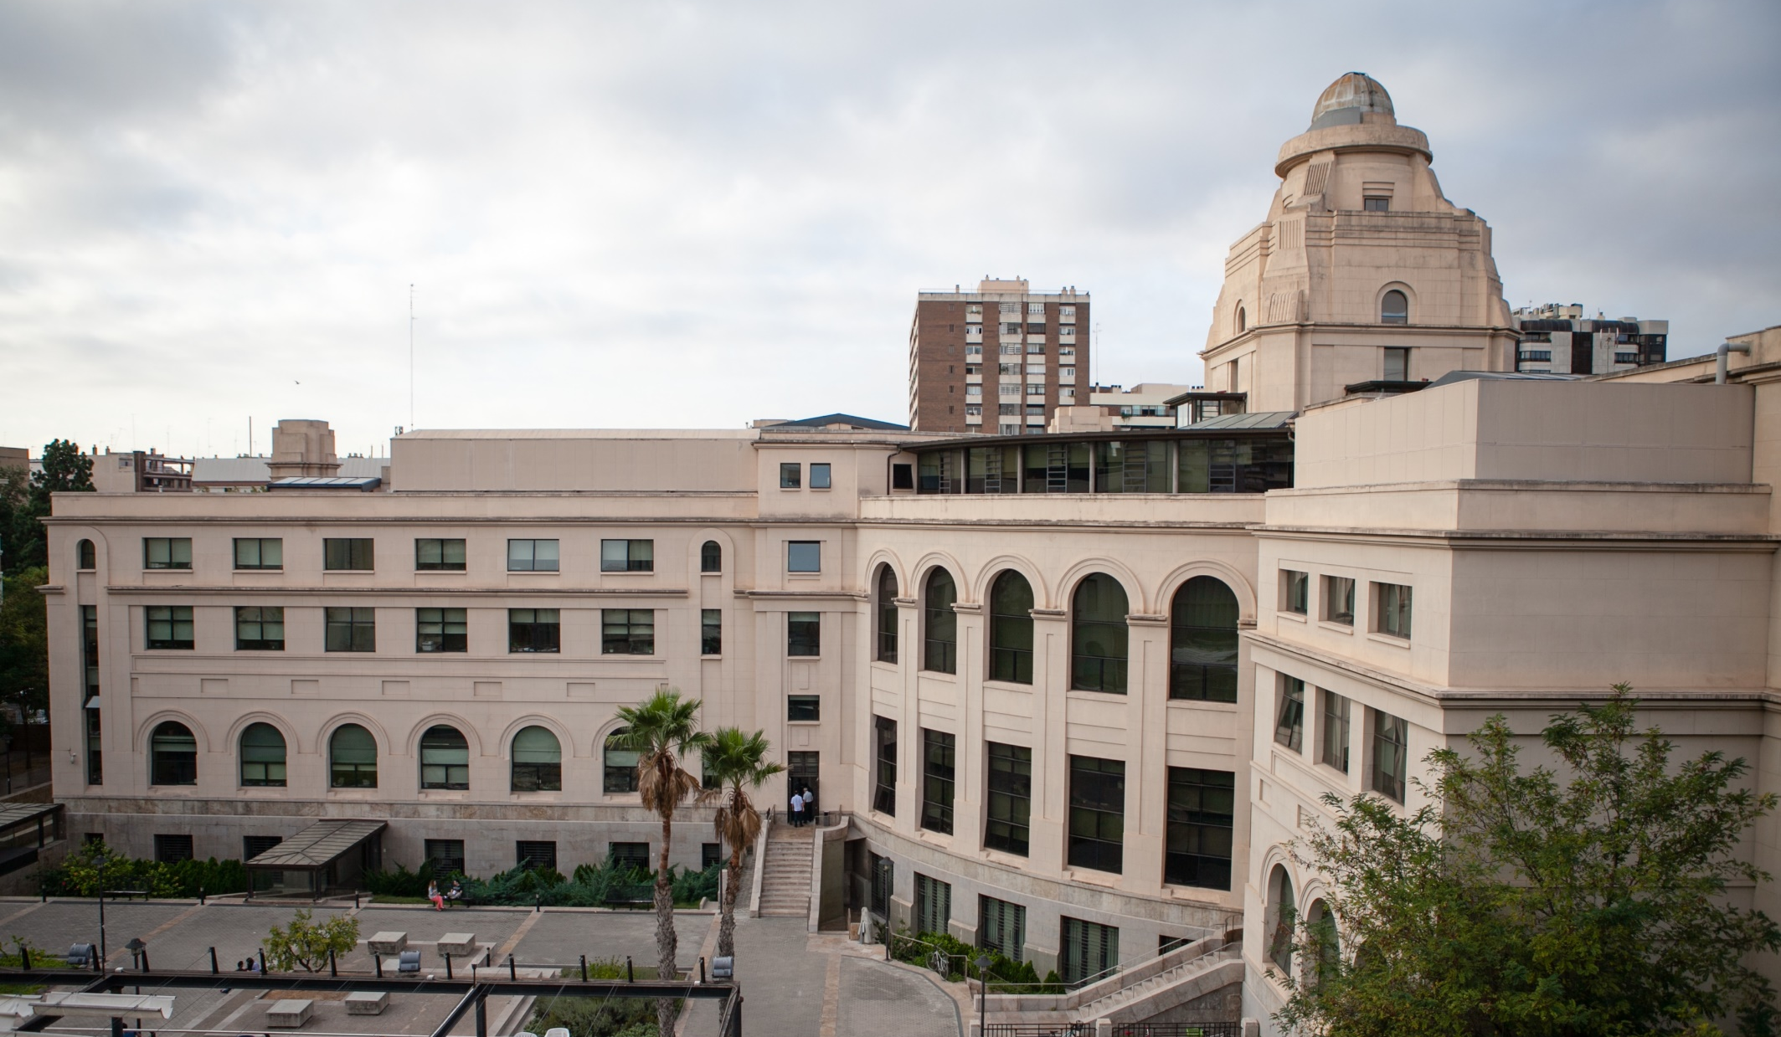
バレンシア大学の導入事例
• 従来のストレージと比較して 3 倍高速
• コストを 40% 削減
• 入学志願者の増加と、スペイン国内外でのリーダーシップの維持
https://www.suse.com/success/stories/university-of-valencia
Notes:
Customer: University of Valencia is one of Spain’s oldest and most prestigious academic institutions.
Challenge: Legacy storage couldn’t support the services students demanded and the school needed.
Solution: SUSE Enterprise Storage on Fujitsu servers
Results:
The storage solution is three times faster than the traditional network-attached storage (NAS) previously used for virtualization.
Thanks to the SUSE solution’s cost-effectiveness, the university has saved 40 percent in storage costs. This enables the university to allocate more funding to value-add projects.
By investing more in internationally acclaimed research projects and services for students, the University can attract more students and maintain leadership in Spain and abroad.

